Slide 1

Doing DevOps Right: Trunk-based Development, CICD, and IaC By Drake Lundstrom
Notes:
Image attribution: Rawpixel.com

Slide 2



Who am I?
Senior Software Engineer at Rouge Fitness
Work with Cloud Migrations and App Modernization on Azure and AWS
Learning and teaching is what I do for fun

Slide 3

What is Operations?
The activities, processes, and practices involved in managing and deploying software systems
How software gets from developer to customer
ChatGPT 4
Notes:
Software doesn’t run on your computer

Slide 4
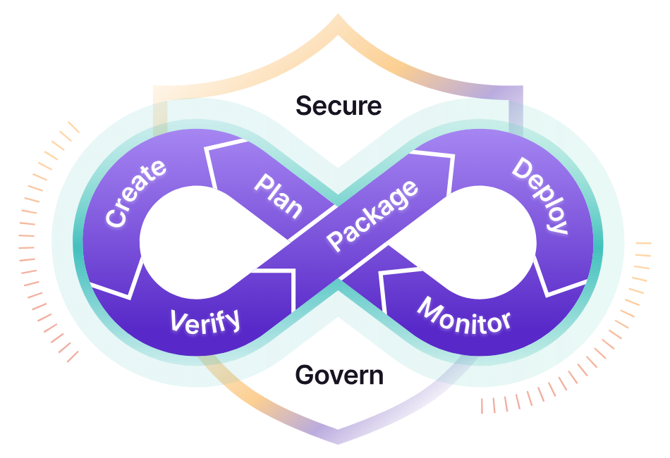
What is Devops?
A philosophy unifying software Development and Operations
Culture of collaboration
Shorten development cycles
Enable faster problem solving and collaboration
https://about.gitlab.com/topics/devops/

Slide 5

Why Does this Presentation Exist?
Devops is not prescriptive
There are better and worse options
Success results in:
Speed
Rapid Delivery
Reliability
Scale
Profit
https://www.pinterest.com/pin/303218987383222840/

Slide 6
DevOps Research and Assessment

Slide 7

IaC: Infrastructure as Code
ChatGPT 4

Slide 8
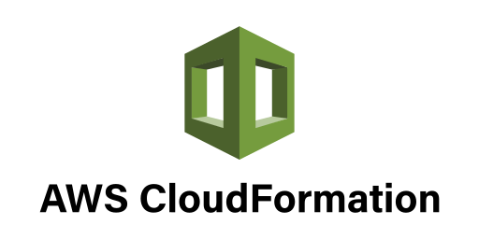
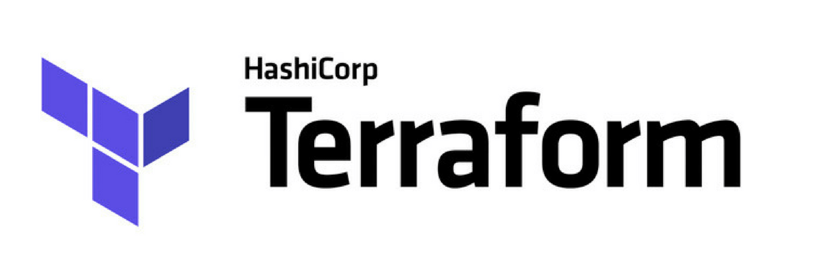
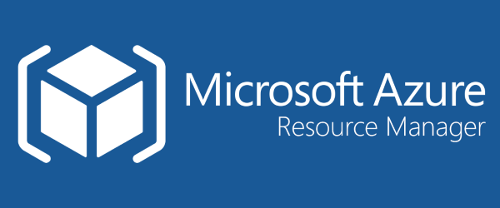
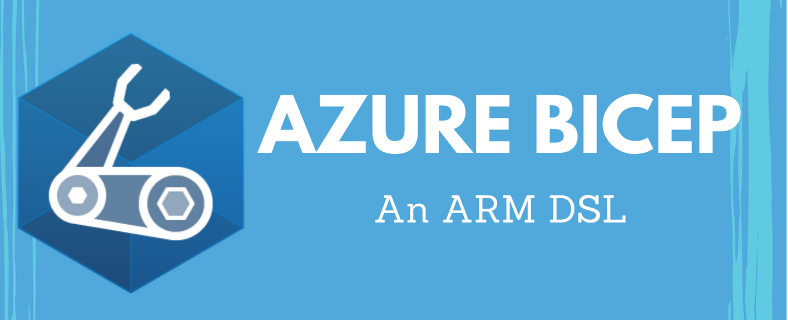
IaC: Infrastructure as Code
Manage resources programmatically
Usually best practice

Slide 9
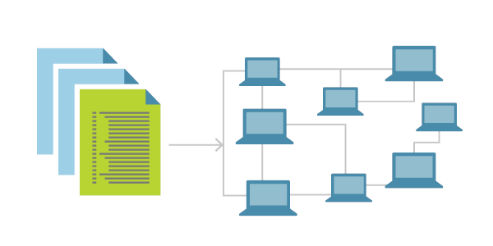
IaC Benefits
Reduction of human error
Faster deployment
Perfect repeatability
Roll back
Easy to scale
Creates change record
https://learn.microsoft.com/en-us/devops/deliver/what-is-infrastructure-as-code

Slide 10
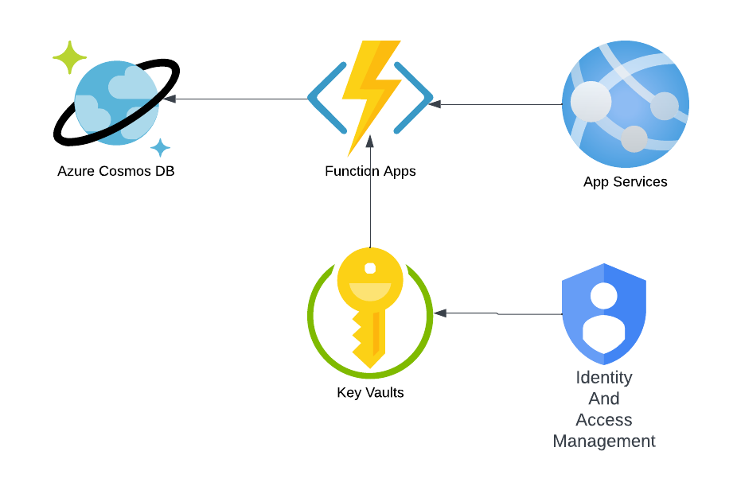
IaC: Infrastructure as Code

Slide 11
IaC: Infrastructure as Code

Slide 12
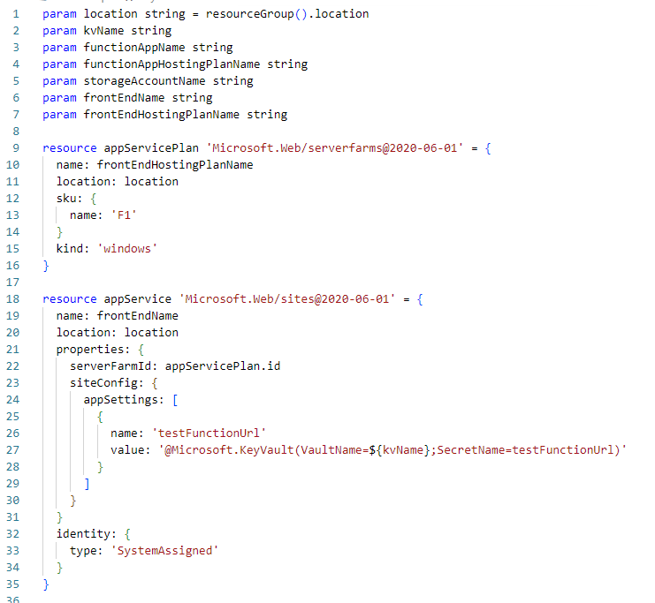
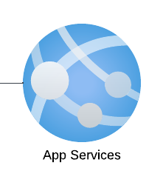

Slide 13
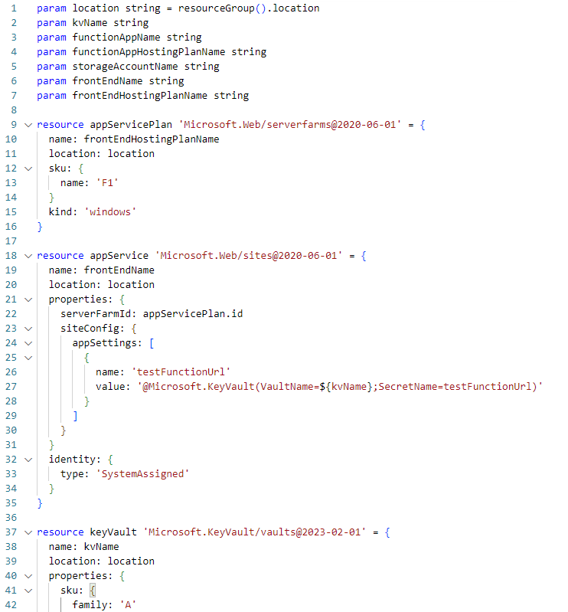
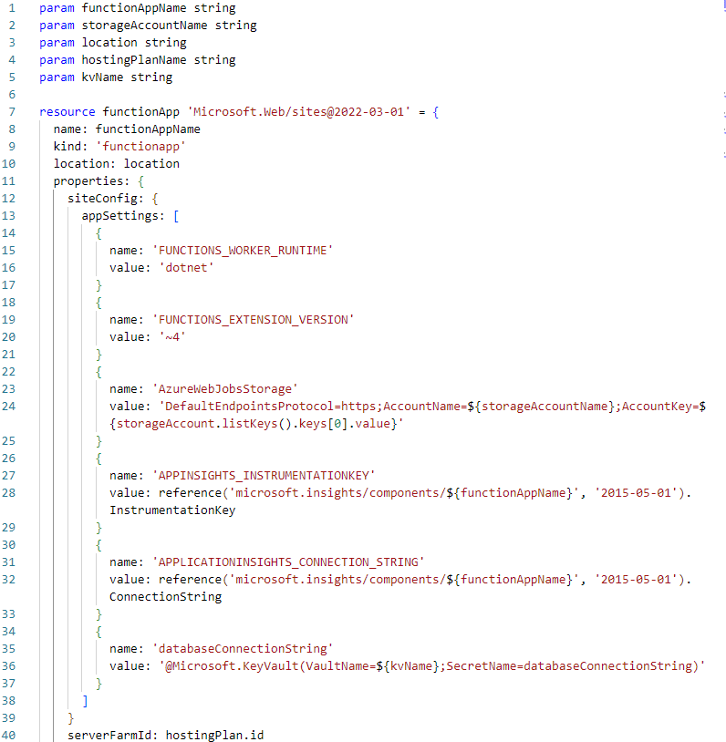
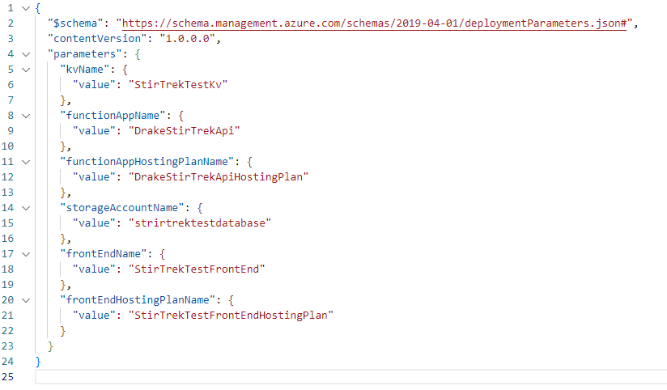
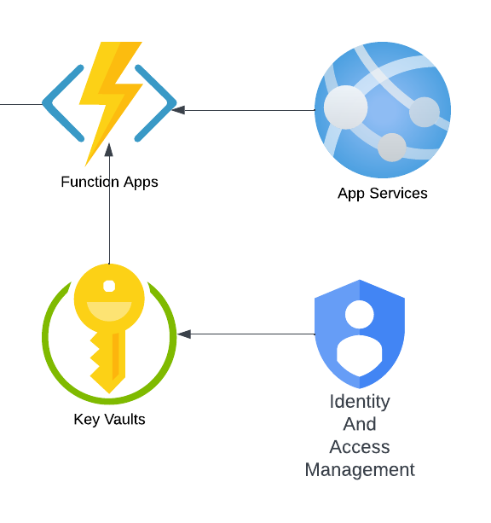
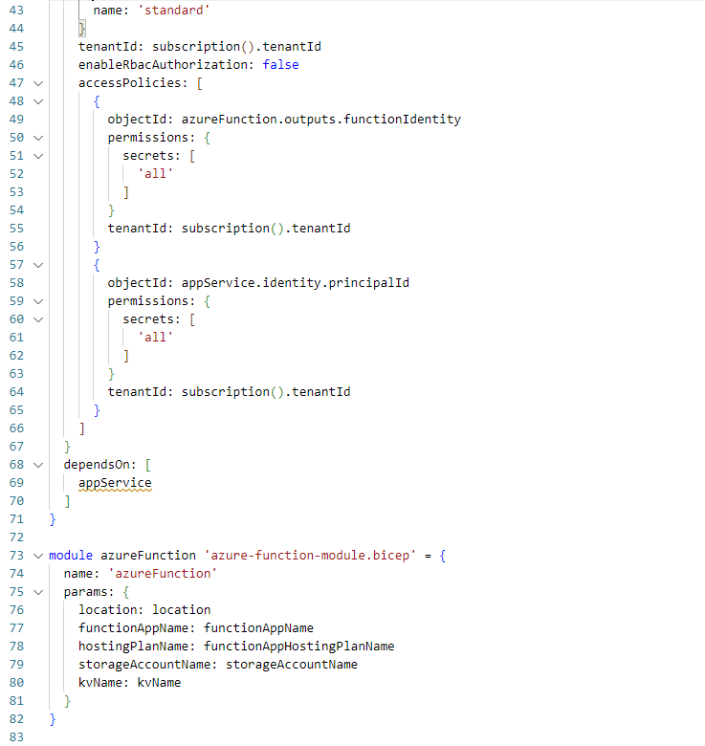
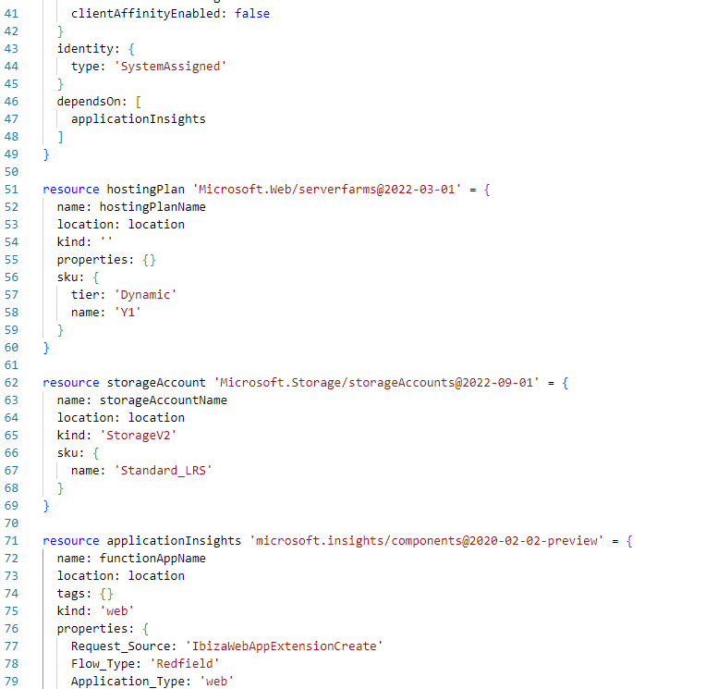
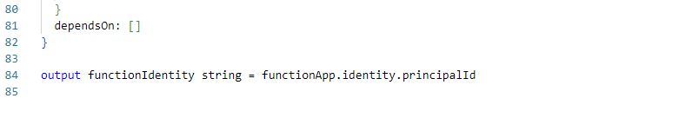

Slide 14

Automate Toil
Toil is:
Manual
Repetitive
Devoid of enduring value
Scales linearly as a service grows
ChatGPT 4

Slide 15
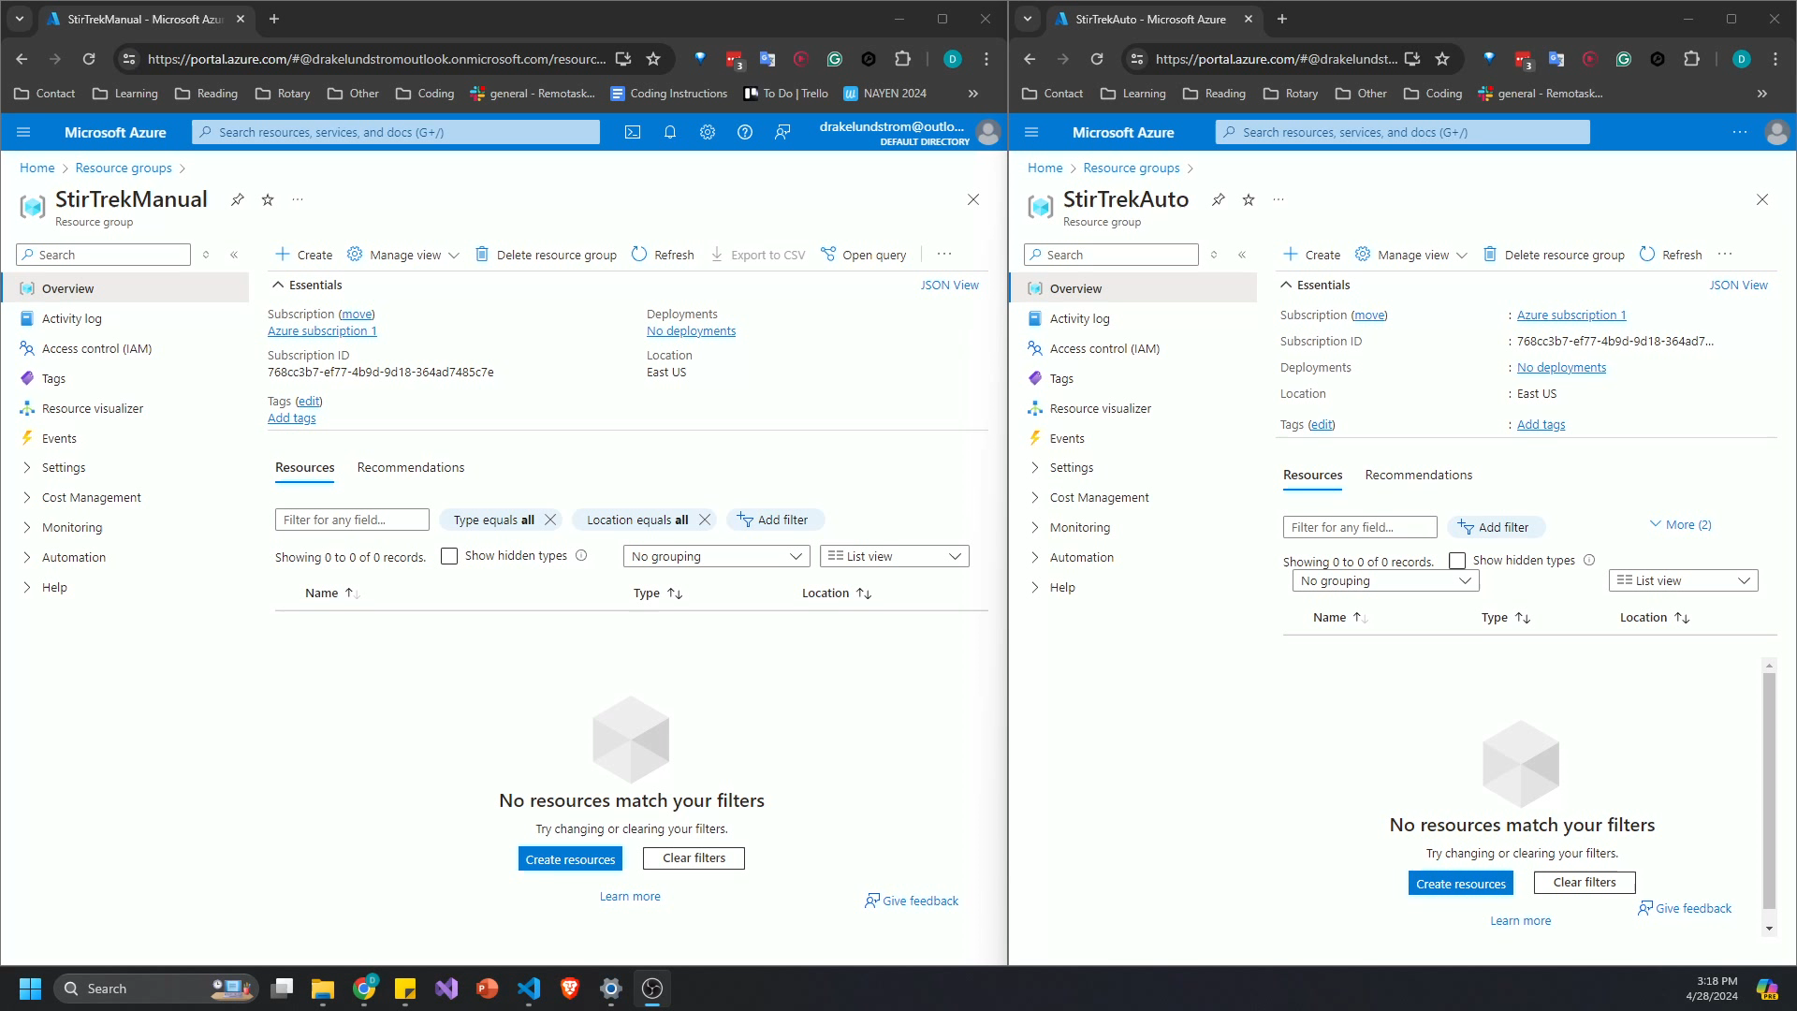
Clickops
IaC
5x

Slide 16
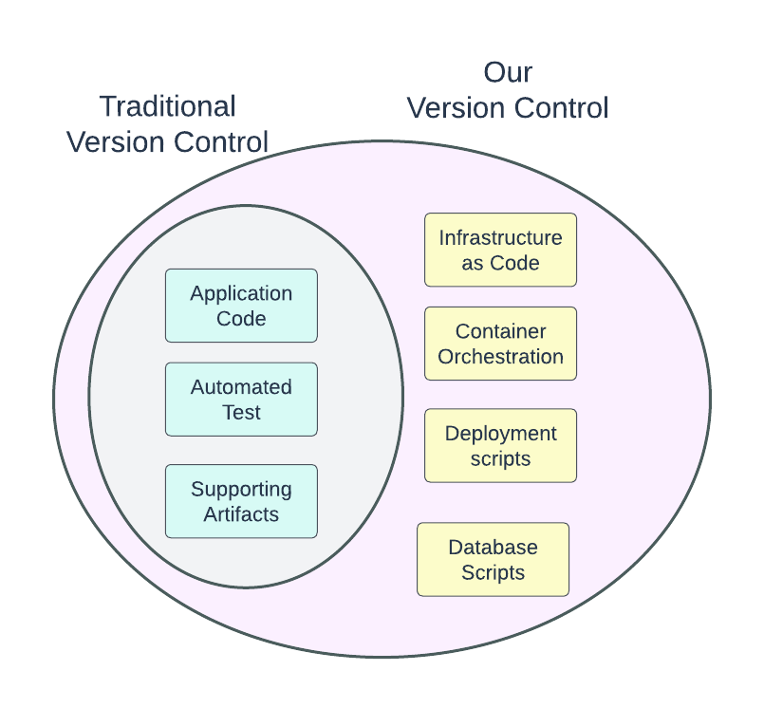
Version Control
Modern
Reproducibility
Traceability
Disaster recovery
Auditability
Higher quality

Slide 17
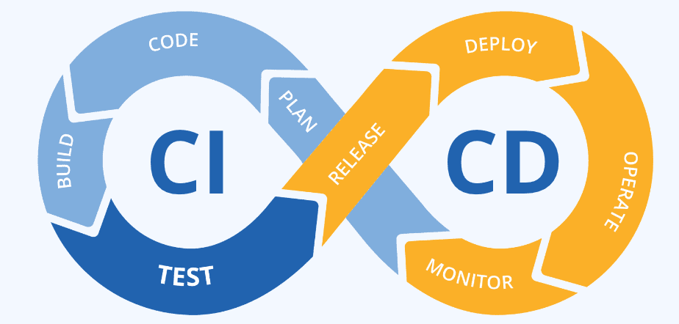
Continuous Integration, Continuous Delivery/Deployment
https://www.linkedin.com/pulse/devops-continuous-integrationcontinuous-deployment-cicd-strategies/

Slide 18

Continuous Integration, Continuous Delivery/Deployment
A culture and process around constantly integrating new code
https://continuousdelivery.com/
ChatGPT 4

Slide 19
Continuous
Integration:
Committed code is built
Resolve integration issues
Resolve deployment issues
Address bugs early
Continuous
Delivery/Deployment:
Pipeline stops on error
Codebase is always deployable
Some/all deployment is automated

Slide 20
Gall’s Law:
“A complex system that works is invariably found to have evolved from a simple system that worked. A complex system designed from scratch never works and cannot be patched up to make it work. You have to start over with a working simple system.”

Slide 21
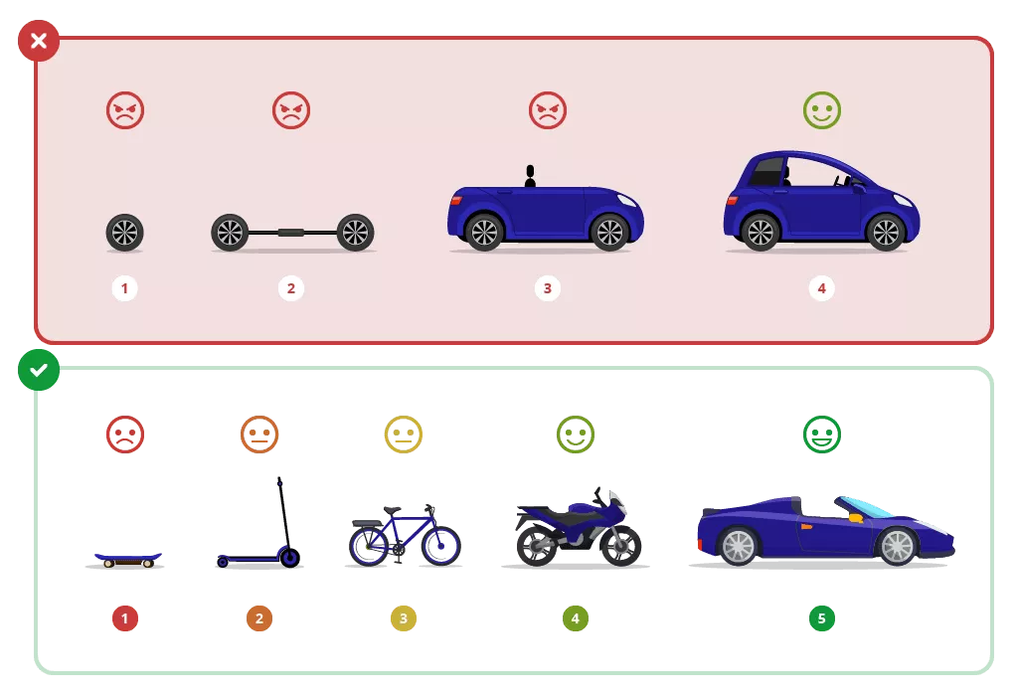
Continuous Delivery
https://viblo.asia/p/what-is-mvp-what-are-the-key-mvp-types-RQqKLNWNl7z

Slide 22
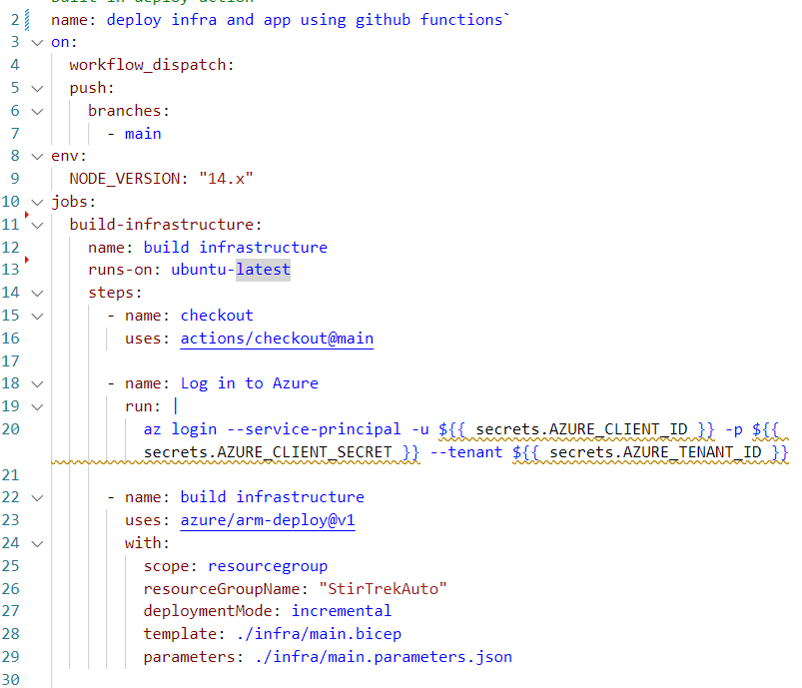
Pipeline

Slide 23
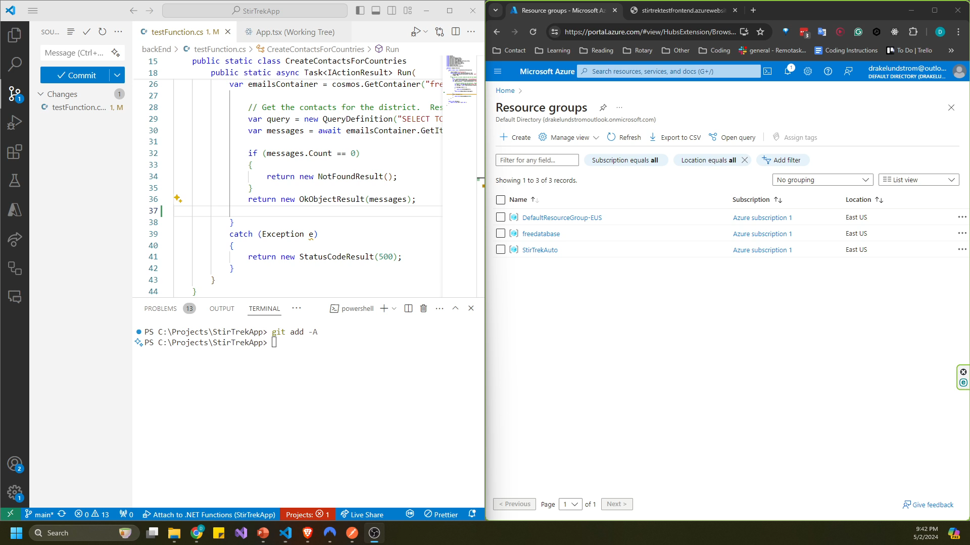
1

Slide 24
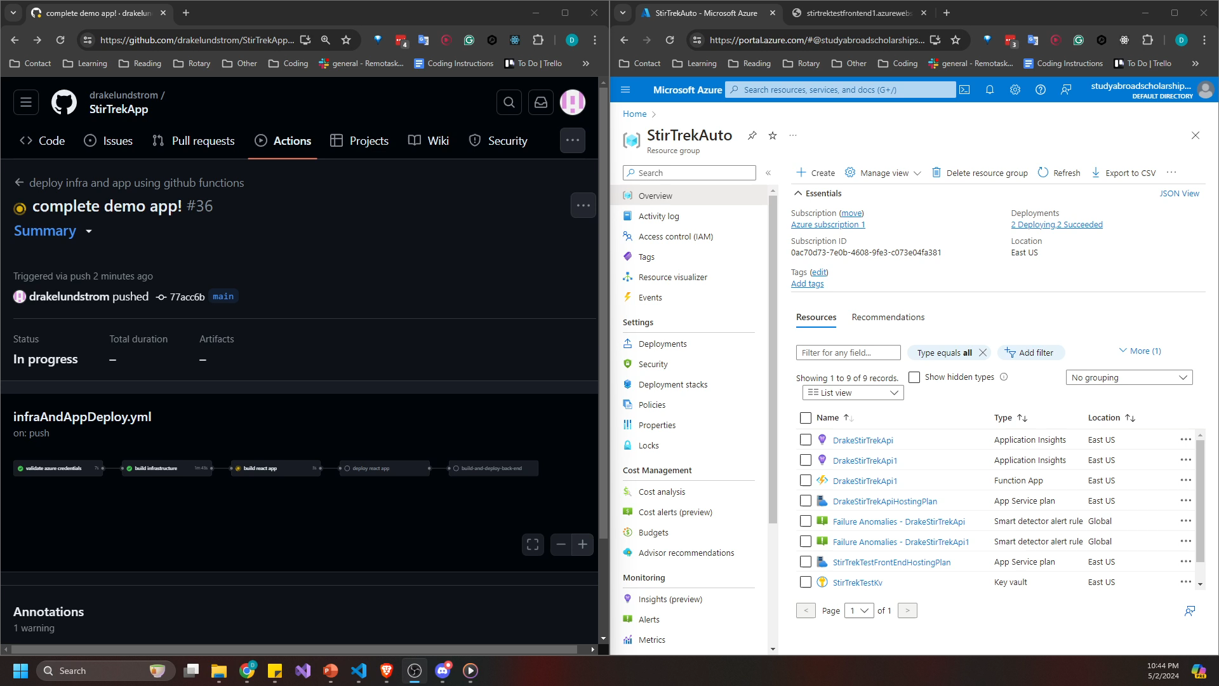
2

Slide 25
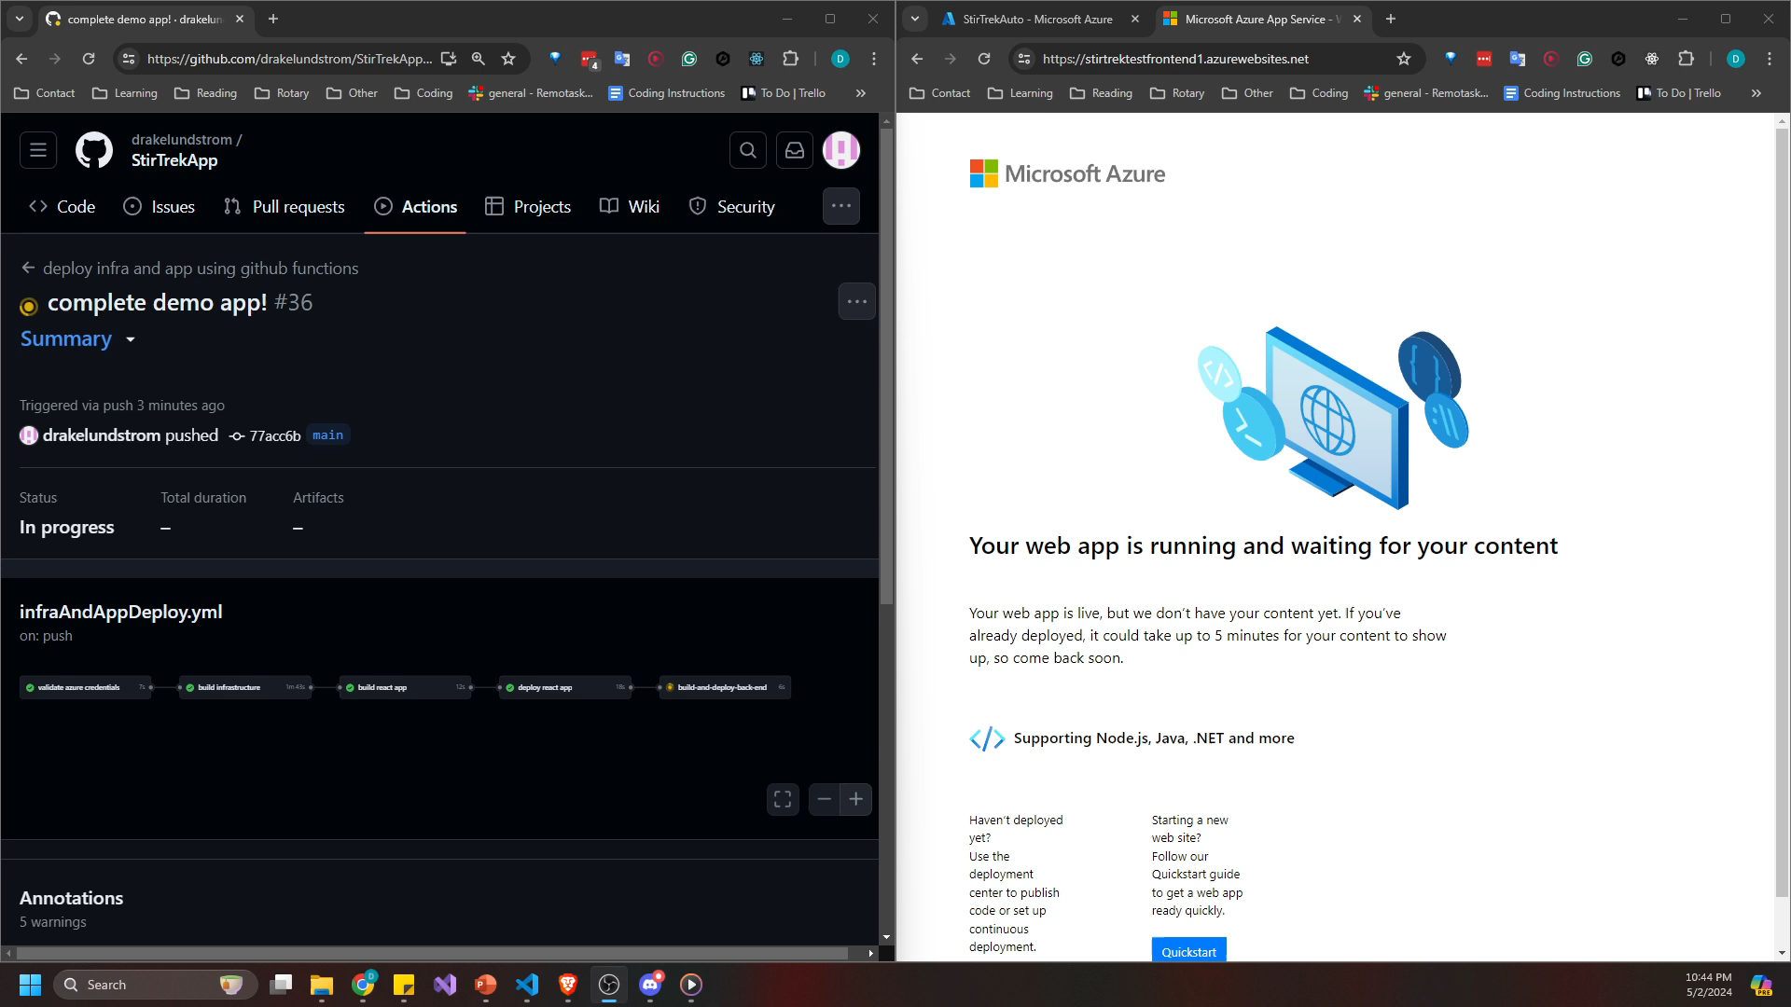
3

Slide 26
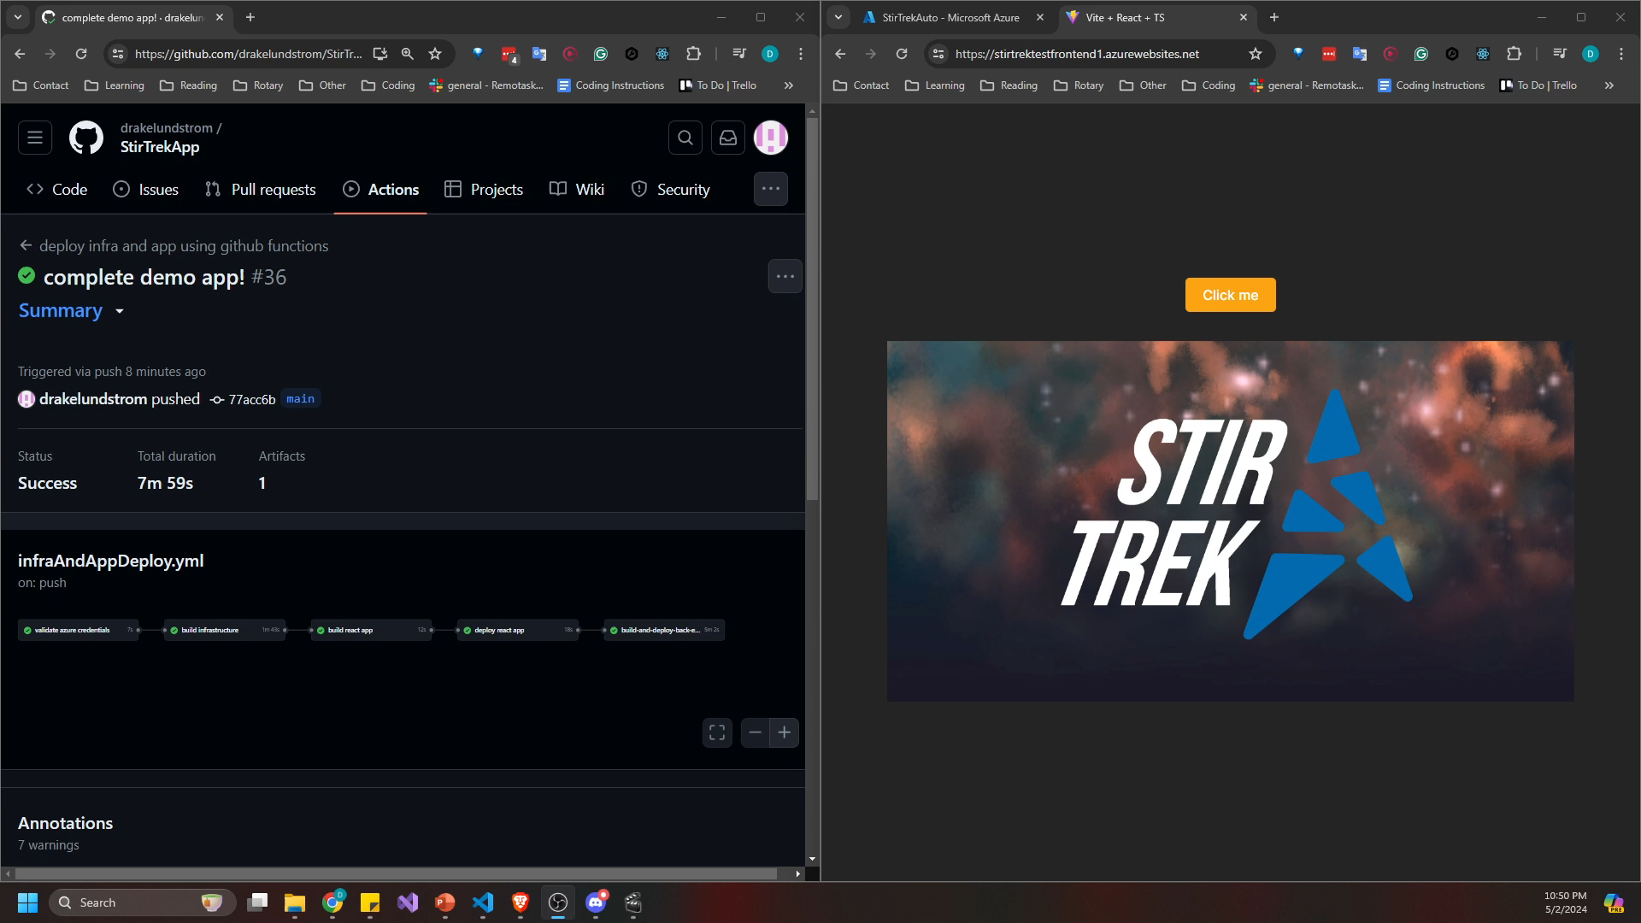
4

Slide 27

Keys to Success
Test in the “real” environment
Automate testing
Reduce toil
ChatGPT 4

Slide 28
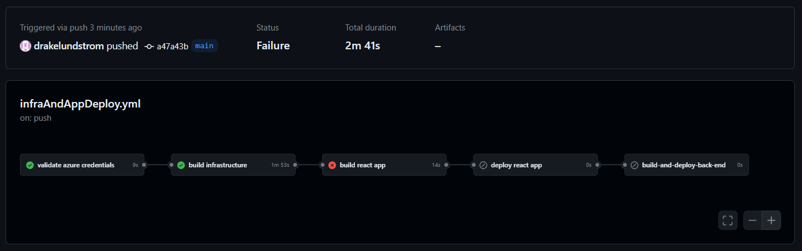

Slide 29
“Bear in mind: continuous delivery is not magic. It’s about continuous, daily improvement — the constant discipline of pursuing higher performance by following the heuristic ‘if it hurts, do it more often, and bring the pain forward.’”
- https://continuousdelivery.com/

Slide 30
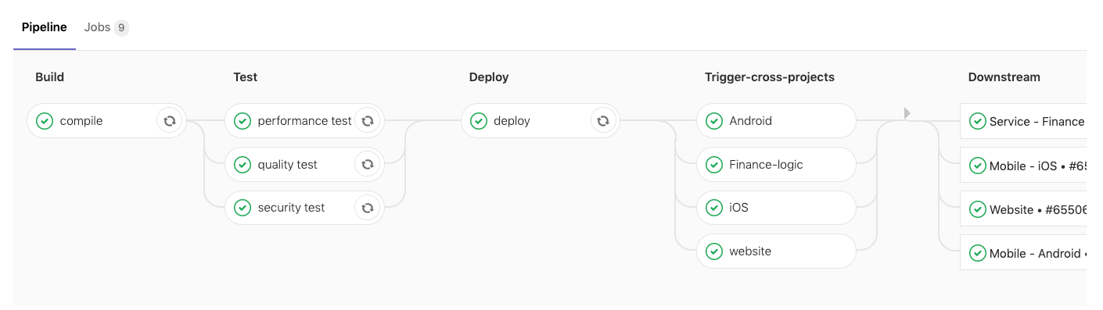
Removing toil makes space for innovation
https://about.gitlab.com/blog/2019/07/24/cross-project-pipeline/

Slide 31
Where do developers come in?

Slide 32
Infrastructure isn’t useful without code to run on it

Slide 33

Trunk Based Development: What is It?
Development is done on short-lived branches that merge into main often
https://trunkbaseddevelopment.com/
https://www.freepngimg.com/svg/4811-large-tree

Slide 34
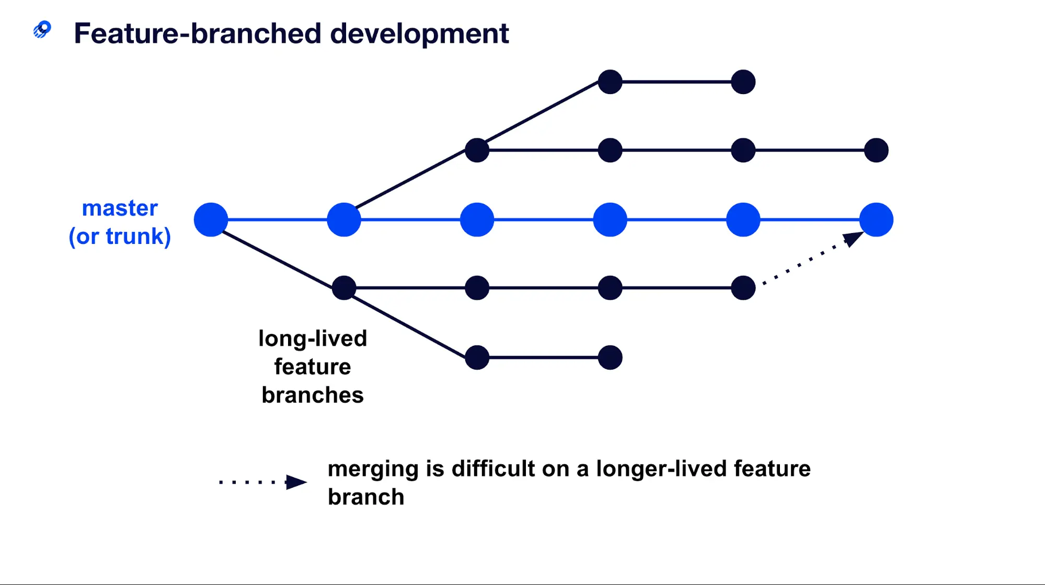
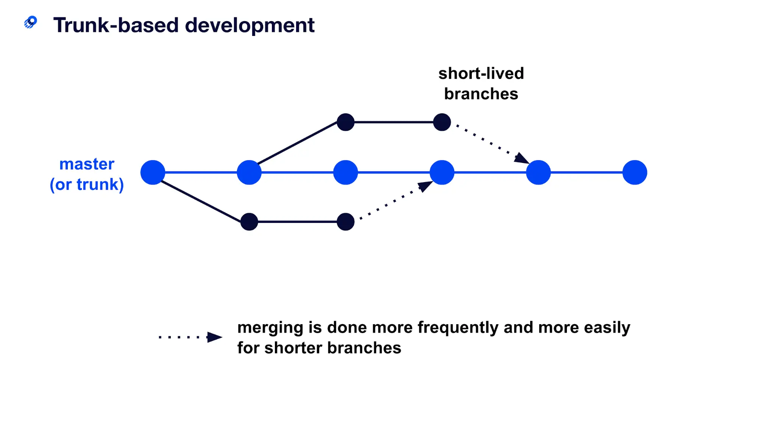
https://www.optimizely.com/optimization-glossary/trunk-based-development/

Slide 35
Trunk Based:
Small stories
Low WIP
Merge to trunk >1 per day
Limit branches
Fast PRs
Feature Branch:
Large stories
Variable WIP
Branches live weeks or months
Many nested branches
Code freezes

Slide 36
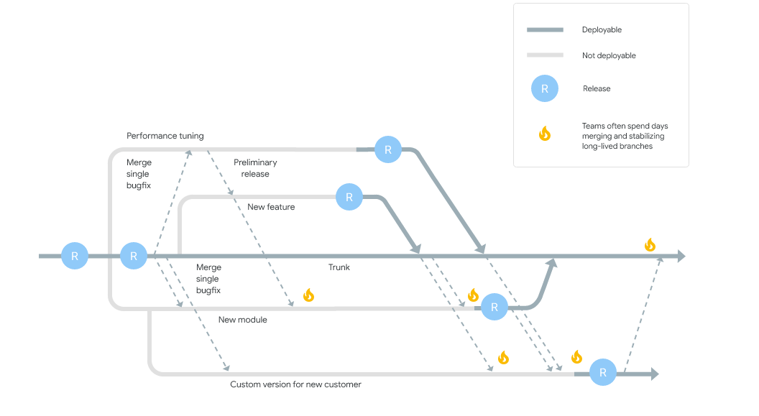
Realistic Feature Branch:
https://dora.dev/devops-capabilities/technical/trunk-based-development/

Slide 37
Trunk Based Development
https://viblo.asia/p/what-is-mvp-what-are-the-key-mvp-types-RQqKLNWNl7z

Slide 38

Trunk Based Development: Remove Friction
Fast PRs
Easy/fast to build
Lightweight review process
Automated pipelines
Automated testing
https://byrslf.co/the-mental-trap-that-keeps-us-from-moving-forward-d03a3a3cba32?gi=3aab5a6d3afb

Slide 39
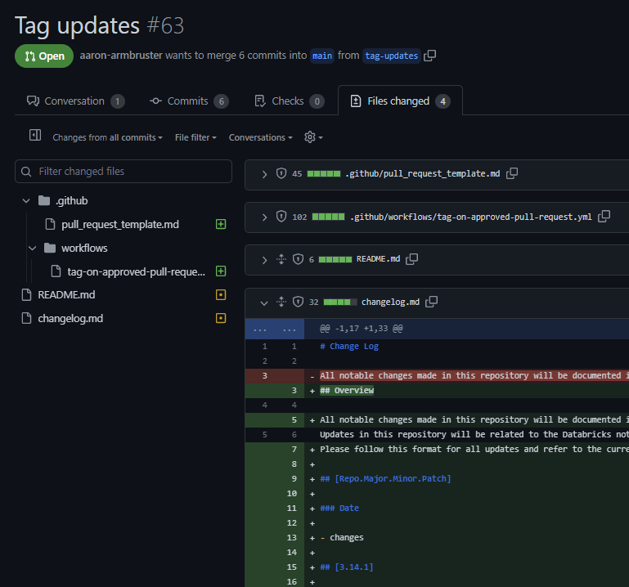
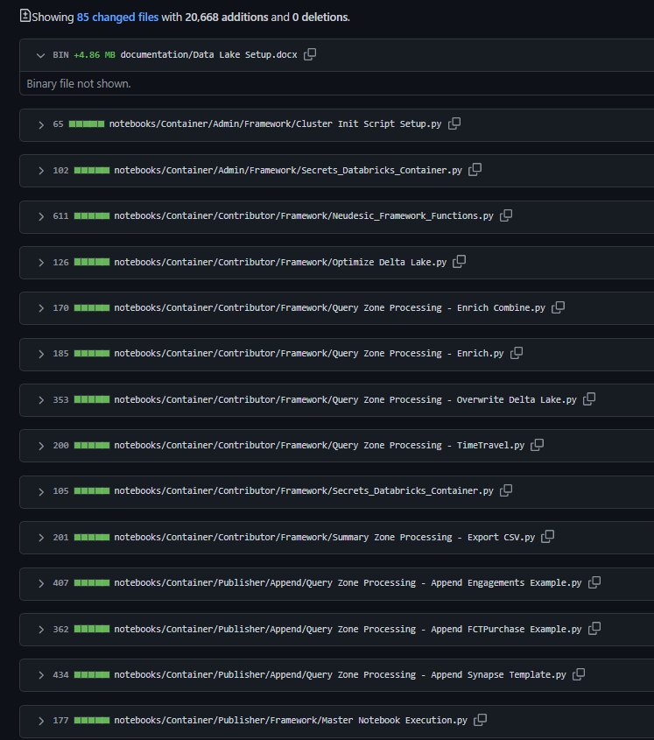
Trunk Based:
Feature Branch:

Slide 40

Lots of PRs: What about Reliability?
Small PRs == Easy rollback
Bugs are the top priority
Automated testing
ChatGPT 4

Slide 41

Complex Features with Dependencies
Spikes
Chunks
Exceptions (like setup)

Slide 42

So we just wait around with PRs?
https://en.wikipedia.org/wiki/File:Aiga_waitingroom.svg

Slide 43

Syncronous, Lightweight PR Review
Team effort
Needs supporting culture
Train reviewers
https://altaworld.tech/duck-creek-technologies-and-copart-to-sign-a-collaboration-for-providing-better-service-together/

Slide 44

Tasks/Ticket Best Practices
Clear acceptance criteria
Vertical slices
Single source of truth
https://www.vectorstock.com/royalty-free-vector/yellow-ticket-with-stars-vector-1269849

Slide 45
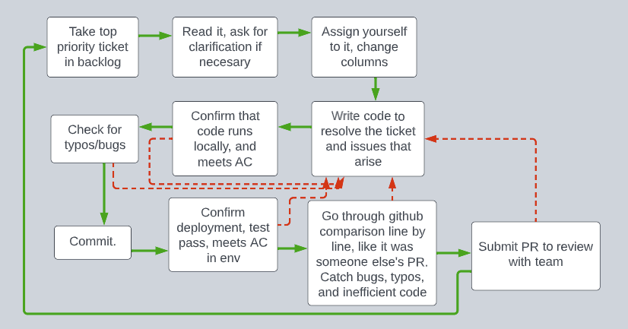
Development Flow Diagram

Slide 46
Don’t Merge Breaking Code
Notes:
Image attribution: Rawpixel.com

Slide 47
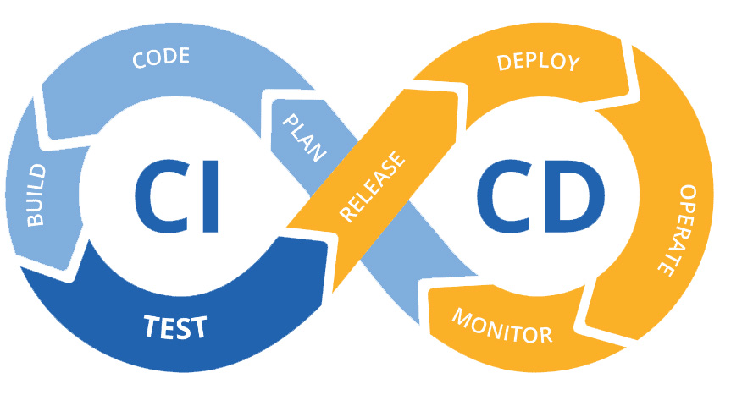
Trunk + CICD + IaC
It all works together

Slide 48

Then everything changed when
DevOps was implemented

Slide 49
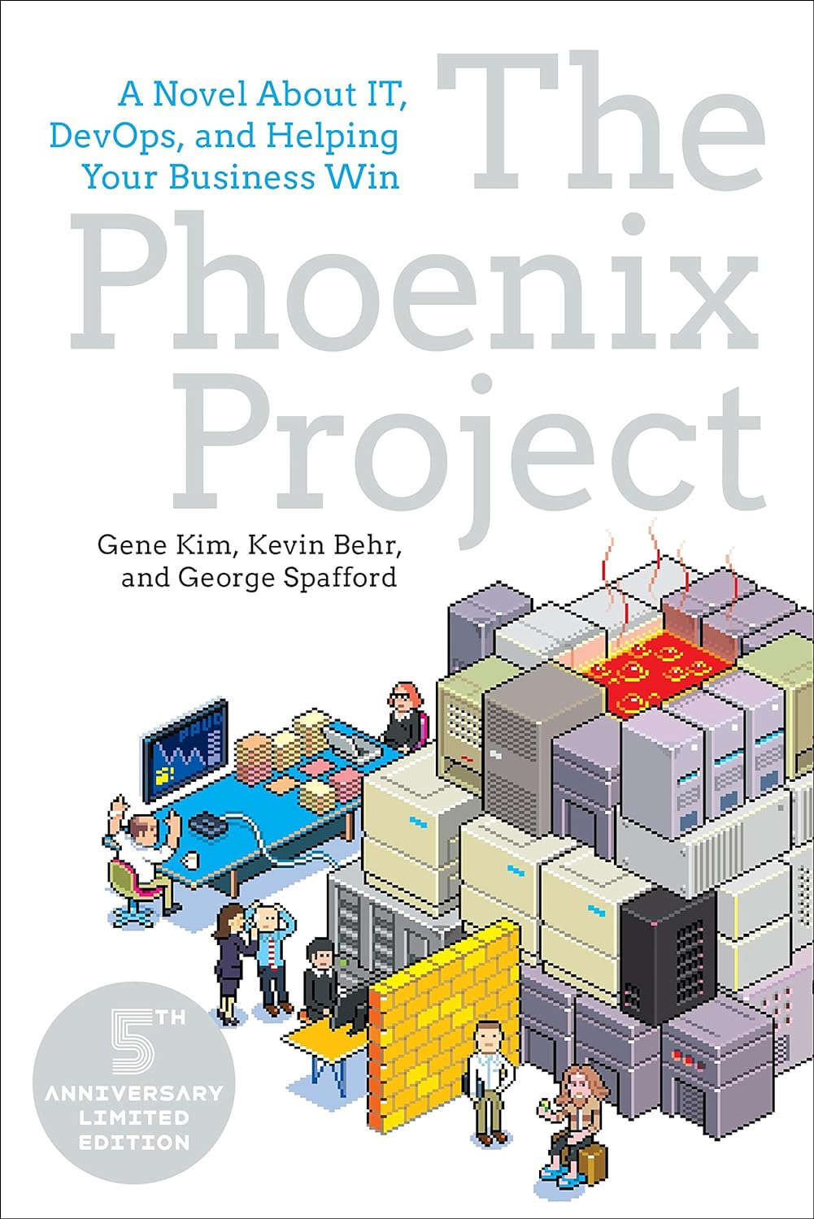
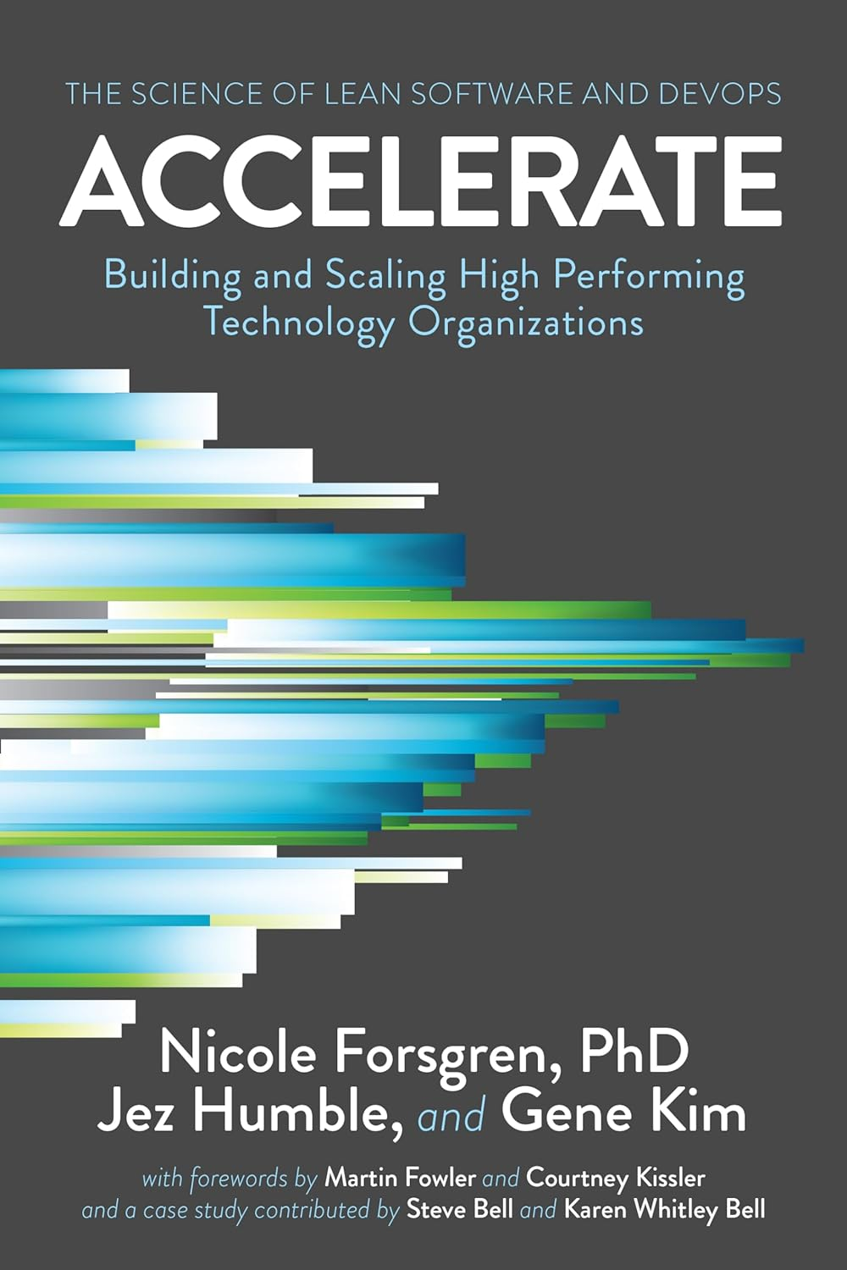

Where Do I Learn More?
https://dora.dev

Slide 50

https://mcc.gse.harvard.edu/whats-new/gratitude-is-more-than-just-saying-thank-you

Slide 51
Questions?
IaC:
Manage infrastructure with a replicable, iterable system
CICD:
Iterate frequently in small chunks
Test in the real environment
Trunk Based Development:
Apply the same lessons to development work

